Slide 1
Community Club Sustainability Program
Best Practice Training

Slide 2
Purpose of CCSP Training
Objectives of the CCSP Best Practice Training
Player Points System (PPS)
Player Point Categories
Player Points Flow Chart
Allowable Player Payment (APP)
APP FAQ’s
APP Investigations
Discussion
Community Club Sustainability Program

Slide 3
Objectives of the CCSP Best Practice Training

Slide 4
Objectives of the CCSP Best Practice Training
The Community Club Sustainability Program Best Practice Training module is designed to support volunteer and employed administrators of community football to better understand and manage the CCSP through recommended best practice.
Ongoing CCSP education and support of administrators is recognised as the key influence which mitigates the risks of compliance, administrative and Cap breaches at club level.
As community football administrators roll over regularly, it necessitates access to annual and ongoing CCSP Best Practice Training and support. AFL Victoria have developed the CCSP Best Practice Training Module to ensure consistent messaging and processes across Victorian community football.
Community Club Sustainability Program

Slide 5
Player Points System

Slide 6
What are the PPS caps for each Regional League in 2023?
BFNL | MCDFNL | CHFL
43 | 42-46 | 42-46
Player points need to be entered into the PLAY HQ database by the clubs.
The Region will not speculate, at any time, on any individual players PPS value and requires a player to be registered to provide advice on PPS values.
Community Club Sustainability Program

Slide 7
How to manage the PPS?
The Player or Players must be registered for the upcoming season
Clubs to determine each individual Player point value. Refer to the PPS Flow Chart (slide 19) and/or PPS Categories (slides 9-18) or PPS Calculator (AFL Vic website)
Clubs must enter the PPS Values of each player into the competition database PLAY HQ
When approximately 75% of a Clubs playing list is entered and attributed a PPS value into the PLAY HQ database, request a review of the list from the relevant league
Community Club Sustainability Program

Slide 8
How to manage the PPS? continued
The League will then review each players PPS value attributed and when complete, lock the clubs ability to amendment
The League shall refer the completed clubs list to the relevant Region who shall make any amendments identified and then the League shall lock the clubs ability to edit any players point value.
At all times, the club shall remain responsible for correctly assessing and entering into the competition database a players correct PPS value.
Clubs must request the League to enter PPS Values of any additional registered players after the system is locked
Community Club Sustainability Program

Slide 9
Player Point Categories

Slide 10
Player Points System – Assessment Categories
Category 1 – 1 Point Home Player
Played 40 or more games over a minimum 3 seasons * (See Clause 5.2.1 for 2020 and 2021 seasons) at that club or aligned junior club up to and including U17 competitions*
Player who has played a minimum of 5 games in each of the 5 consecutive seasons for the club or the aligned junior club up to and including Under 19’s
Player who has only played at that club or aligned junior club.
Player who hasn’t played Competitive football in the previous 36 months.
Community Club Sustainability Program

Slide 11
Player Points System – Assessment Categories
Category 2 – 2 Point - Development Community Player
- Played more reserves games than senior games in total, over the current and previous three (3) Seasons at community football level
Community Club Sustainability Program

Slide 12
Player Points System – Assessment Categories
Category 3 – 3 Point - Senior Community Player
- Played the same or more senior than reserves games in total over the current and previous 3 seasons. Also includes Interstate Community Leagues including NTFL.
Category 3 – 3 Point – Transferred Junior
- Player recruited from an U19’s or younger competition and does not meet the Category 1 home club definition
Community Club Sustainability Program

Slide 13
Player Points System – Assessment Categories
Category 4 – 4 points - NAB League Player
Played at least 5 Coates League games in any of the current or previous 3 seasons
Category 4 – 4 points - State League Tier 2 - TASFL
Played at least 5 senior games in any of the current or previous 3 seasons
Community Club Sustainability Program

Slide 14
Player Points System – Assessment Categories
Category 5 – 5 points - State League Tier 1 - VFL, WAFL, SANFL
Played at least 5 senior games of VFL, WAFL or SANFL in any of the current or previous 3 seasons
Category 6 – 6 points – AFL Player
Played at least one AFL game in any of the current or previous 3 seasons.
Community Club Sustainability Program

Slide 15
Player Points System – Assessment Categories
Clarification of previous 3 seasons for 2023.
Season 2022 – 0 games
Season 2021 – 6 games
Season 2020 – 2 games; or
Season 2022 – 5 games
Season 2021 – 0 games
Season 2020 – 0 games.
Where a Category refers to “a minimum of 5 games in any of the previous 3 Seasons”, the above calculation example will apply
Community Club Sustainability Program

Slide 16
Player Points System – Additional Point Categories
If a player transfers to a Community Club and will be competing against their immediate former Community Club, (except Category 2 - Development Community Players) an additional one-point penalty will apply.
Note: Regions/Metro Leagues may apply an additional two-point penalty depending on their environment
If a player transfers from a Community Club located in a Premier Competition to a Community Club in a non-premier competition an additional one-point penalty will apply
- Refer to list of Premier Competitions
Community Club Sustainability Program

Slide 17
Player Points System – Additional Point Categories
Where a player has registered at three (3) or more different Community Clubs in three (3) seasons, one additional point will be applied to that player’s Player Points Allocation.
In determining the 3 season’s timeframe, clubs shall assess the current or upcoming season as the first season along with the previous two (2) seasons.
Club A – 2023 season
Club B – 2022 season
Club C – 2021 season
Community Club Sustainability Program

Slide 18
Player Points System – Additional Point Categories
Where a player qualifies in more than one Category based on their playing history in the current Season or any of the previous 3 Seasons, the Category with the highest points will apply, hence the use of the flow chart
(Category 1 - Home Players are excluded).
Community Club Sustainability Program

Slide 19
Player Points System – FLOW CHART

Slide 20
Player Points System
DELEGATION BY Regions to LEAGUE by agreement
3.10 Country Regions may, under written agreement with the affiliated Country leagues, delegate authority regarding Total Team Point allocations (under clause 8.1 and 8.2), or Individual Player Point assessments (under clause 7.3). Any such delegation must include final endorsement by the relevant Region of any allocation or assessment made by the affiliated Country league.
Community Club Sustainability Program

Slide 21
Reassessment of an Individual Player Point Value
Once the point value of the player has been confirmed and locked by the League a club may request a reassessment
The request must be made within 7 days of the points being allocated and club notified
The request must address the matters as per clause 7.3 of the AFL Victoria Player Points System Policy but addressing the criteria does not guarantee a positive reassessment
The Regions Player Points Panel (PPP) will consider the application on merit
An appeal against the PPP is to the Regions Governing Body
Community Club Sustainability Program

Slide 22
Allowable Player Payments

Slide 23
What are the APP’s for each Region League in 2023?
BFNL | CHFL | MCDFNL
$100K | $85K | $75K
APP’s will be monitored annually and consideration given to future Caps with the obligation on the Region to confirm APP’s annually by 31st August the previous year for the following year
Established Caps are all inclusive with margins, payments, expenses, allowances and obligations included in one amount.
Community Club Sustainability Program

Slide 24
How is the APP managed by clubs?
An Allowable Player Payment is determined for each competition
Clubs are not to exceed Allowable Player Payment
By 14 days of a clubs first game, on templates provided Clubs must lodge;
Player Declarations (previously Player Contracts)
Non Declared Player Summary
Player Payment Budget
Clubs must lodge an Actual Player Payment Declaration on or before 31st October annually on the template provided
Community Club Sustainability Program

Slide 25
How to manage the APP?
The Player or Players must be registered for the upcoming season
Players receiving above the IPP Threshold sign a Standards Player Declaration which includes all payments and benefits associated with playing football for the club
Players receiving at or below the IPP Threshold sign a No Declared Player Form. Multiple players listed on the Form. They are declaring that they receive at or less than the IPP Threshold per games including all payments and benefits associated with playing football for the club
Community Club Sustainability Program

Slide 26
How to manage the APP? continued
Clubs complete the templated APP Budget Spreadsheet which reflects all declared and non declared players, coaches payments and other relevant inclusions under the APP Regulations
Clubs can also identify any deductions applicable under APP regulations
The Club must lodge all declared player forms, non declared players forms and the Clubs APP Budget (in excel format) into the clubs designated APP Portal by 14 days after the clubs first game.
Clubs may make amendments to Player Declarations and submit additional Non declared player forms during season as new players may register at the club.
Community Club Sustainability Program

Slide 27
How to manage the APP? continued
By October 31st annually, clubs must submit their Final APP Declaration which reflects the clubs total, all inclusive payments to players, coaches etc. as required under the APP Regulations.
Actuals should correspond with Player Declarations, individual games played, non declared player and games played, coaches payments and any applicable deduction.
Budgets and Final APP Declaration MUST be submitted in the portal as an excel spreadsheet as provided for.
At all times, the club shall remain responsible for correctly equating their player payments to ensure they do not breach the respective APP Cap.
Community Club Sustainability Program

Slide 28
Allowable Player Payments FAQ’s

Slide 29
Does every player have to Sign a Player Declaration?
No
The Region will set an Individual Player Payment (IPP) threshold annually by August 31st each year for the following season. (AFL GF $100.00)
Players receiving payments below the IPP are not required to have an Individual Player Declaration but the payments are still included in the APP and these Players must sign the Non Declared Player Summary
All Players receiving payments above the IPP are required to sign a player declaration
Community Club Sustainability Program

Slide 30
The Player Declaration

Slide 31
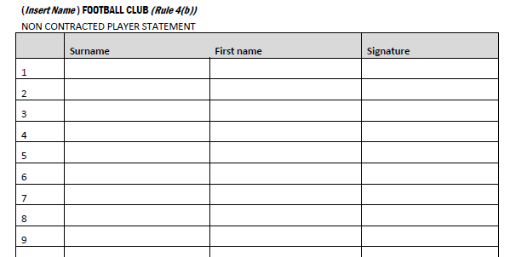
Non Declared Player Summary
Community Club Sustainability Program

Slide 32
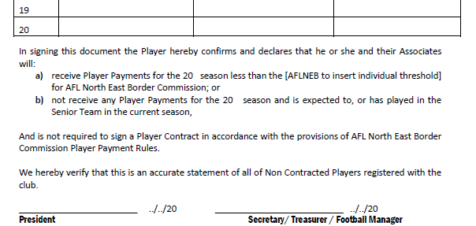
Non Declared Player Summary
Community Club Sustainability Program

Slide 33
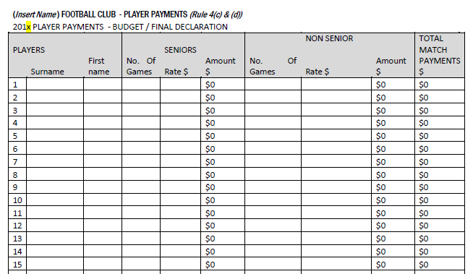
APP Player Payment Budget/Final Declaration
Community Club Sustainability Program

Slide 34
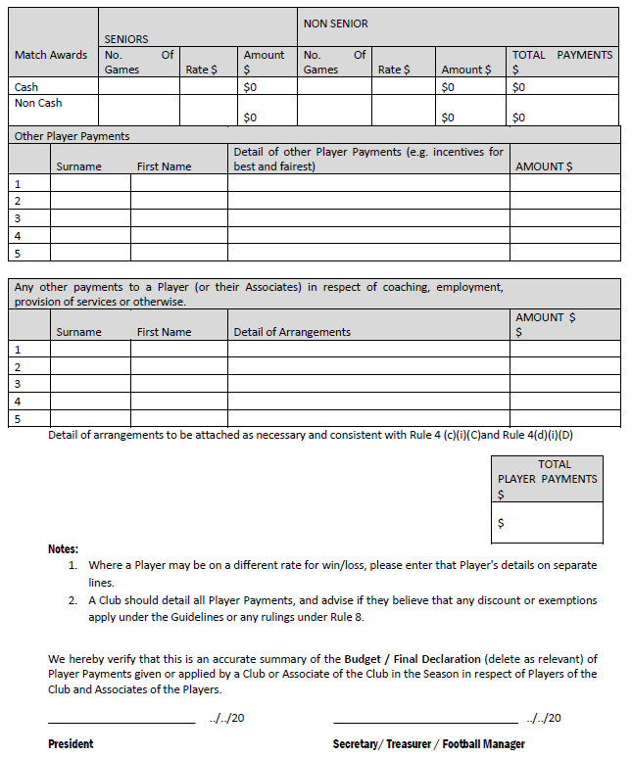

Slide 35
How are Non Playing, Playing, Co-Coaching and Assistant Coach payments to be managed?
Non-Playing Coaching payments are excluded in the APP
Playing Coaches are included in the APP calculations
Payments to a playing coach, to a maximum of $20,000 may be excluded from the calculation of the Club's Player Payments.
For example, playing coach is paid
$30,000 Coach payments is $15,000 included and $15,000 excluded
$50,000 Coach is $30,000 included and $20,000 excluded
Playing Coaches payments are calculated by combining any playing and coaching amounts and are not considered separately in the calculations of the excluded percentage
Community Club Sustainability Program

Slide 36
How are Non Playing, Playing, Co-Coaching and Assistant Coach payments to be managed?
Co-Coaches where at least one is playing their payment will be included in the APP as follows;
50% to a maximum of $10,000 may be excluded from APP calculation for the playing co-coach
The rule only allows for two co-coaches, seek clarification for any alternative by a ruling under 8(d)
Example, if a playing coach and non-playing coach are paid $15,000 each, then $7,500 of the playing coach payment would not be a Player Payment and would not be included in the calculation
All payments to Playing Assistants are included in the APP
Community Club Sustainability Program

Slide 37
How are Non Playing, Playing, Co-Coaching and Assistant Coach payments to be managed?
All payments to the coach must be specifically detailed in the Player Declaration and the Declarations lodged by the Club under Rule 4(a);
The relevant playing coach or other team coach must hold a current AFL Coaching Accreditation;
The relevant playing coach or other team coach is specifically identified on the team sheet for the relevant Match to which the payment applies.
Players who Coach a Reserves or oldest Underage Team within the club up to $3,000 may be excluded from APP, must be included on the Player Declaration
Community Club Sustainability Program

Slide 38
How are Non Playing, Playing, Co-Coaching and Assistant Coach payments to be managed?
When in doubt regarding a status of a coaching arrangement, Clubs should seek advice from the Region Manager or a Ruling from the Region under 8(d).
Community Club Sustainability Program

Slide 39
Are Best Player Awards included in the APP?
Cash Awards are included in the APP and can be collectively recorded on the Club Budget
Non Cash Awards, up to the value of $300 per week including a maximum of $100 per player does not have to included in APP Calculations
If above $300 Per Game or $100 Per Player the full amount is to be included
Community Club Sustainability Program

Slide 40
What is included in the APP?
Any payments or benefits made to a player or an associate of a player by a club or an associate of a club
Includes all payments to all players registered with a club - Seniors, Reserves and Underage
Club related expenses and deductions (Must be identified in the contract)
Community Club Sustainability Program

Slide 41
What is included in the APP?
Finals, Sign on fees, injury payments*, bonus payments, lump sums
*Injury payments/fundraisers for players may be excluded on application
Travel and Accommodation made to players – where in doubt seek a ruling under 8(d)
Payments are all inclusive of any relevant obligations
Community Club Sustainability Program

Slide 42
What is excluded from the APP?
Insurance Premiums made on a Team Basis
Travel & Accommodation made on a Team Basis
Additional insurances (including Health/Income) obtained on a Team Basis
Media and/or League Awards provided to the player
Community Club Sustainability Program

Slide 43
What is excluded from the APP?
Loss of income paid to a player via insurances obtained by the club
Non-cash benefits/awards up to $300 per week, per club to a maximum of $100 per week for any one player
Team Basis definition is the benefit is available to every registered player
Community Club Sustainability Program

Slide 44
The Player Declaration (referred to as Player Contract)
The supplied format to be used is online at www.aflvictoria.com.au
Clubs may attach additional Terms & Conditions of the declaration and lodge with the Player Declaration
The onus is on the player and the club to declare all payments they shall receive to play football
Figures in the Player Declaration must correspond to the Player Payment Budget
Community Club Sustainability Program

Slide 45
Can clubs get a variation to the APP?
Clubs may make application to the Region for a variation to the APP, similar to the PPS, within 60 days of the Region’s notification of the cap based on specific circumstances under Rule 8(d)
Location, relative to population bases
Significant hardship or lack of on field success
Age of Club or recently merged
Access to underage team
Other circumstances deemed relevant
The request must be submitted on the relevant reassessment Form but addressing the criteria does not guarantee a positive reassessment
Community Club Sustainability Program

Slide 46
What about Employment and Provision of Services?
For the purposes of the Player Payment Rules, when assessing whether an employment or provision of services arrangement with a club or associate of a club is bona fide, consideration will be given to commercial practices, market rates and relevant industry awards
Payments associated with the operations of the club must be declared. Clubs may apply for a ruling in relation to their value for the purposes of the Player Payment Rules
Seek a ruling from the Region under 8(d)
Community Club Sustainability Program

Slide 47
Compliance and Breach Risks ……
Lodgement of budget within timeframes
Lodgement of Player Declarations
Lodgement of Non Declared Player Forms
Lodgement of final Actual Budget declarations
Timeframes will be monitored for compliance. Clubs experiencing any issues must communicate with their Region Manager
Community Club Sustainability Program

Slide 48
Compliance and Breach Risks ……
Inconsistent Budget to Player Payment Declarations
Reporting of payment for travel/accommodation for individual players and/or teams
Reporting of cash or non-cash awards to players across all grades
Budgeting over the Clubs APP Cap
Breaching the clubs APP Cap
Timeframes will be monitored for compliance. Clubs experiencing any issues must communicate with their Region Manager
Community Club Sustainability Program

Slide 49
APP Player Payment Budget/Final Declaration
Community Club Sustainability Program

Slide 51
Audit Issues from experiences State-wide
Audits were conducted on Country and Metro Clubs in 2022
Some of the Issues Raised;
Game tallies for players – Play HQ/SPORTS TG v Final Declaration
Contracts incorrectly reflecting actual payments
Financial Reports not reflecting figures in Final Declaration
Non-Contracted Player Summary not signed by individuals
Reporting on Player Coaching Payments
Community Club Sustainability Program

Slide 52
How is the APP to be enforced?
The Integrity Officers or the Region shall determine the value of all or any payments or advantage provide for the benefit of the player by the club or associate of the club or player
Failure to satisfactorily explain payments shall be deemed as a payment to the player and included in the APP
Where it is deemed by the Region that any person or club has engaged in conduct in breach of the APP rules, a charge maybe laid against:
The club or player
Where Rule 2 (b) applies, the Club
Community Club Sustainability Program

Slide 53
How is a charge heard and by who?
A Region shall appoint a Payment Player Disciplinary Committee who shall hear and determine any charge laid under the Player Payment Rules
The Committee shall consist of 3 persons including a Legal Practitioner who shall act as Chair and 2 other persons
At a hearing, the Disciplinary Committee shall decide any charge on the balance of probability whether a club or player has or hasn’t engaged in the alleged conduct
A club or Player charged shall bear the onus of establishing on the balance of probability that the alleged conduct was not engaged in
Community Club Sustainability Program

Slide 54
What types of breaches could occur?
A breach of the APP Rule could occur when:
Procedurally, where clubs do not lodge or do not lodge on time, Player Payment Budgets, contracts, non contracted player declarations and Actual Payment schedules
Non compliance with an Integrity Officer
Where a player and or club does not declare the total player payments being received
Where a club exceeds their Allowable Player Payments
Community Club Sustainability Program

Slide 55
What sanctions apply for breaches?
For breaches of the APP Rule, at the absolute discretion of the Disciplinary Committee maximum sanctions as listed in the rule may include:
Monetary sanction to a maximum of $15,000 for clubs and players
For breaches of the clubs AAP (Rule 2) and where no maximum sanctions apply, sanctions may include:
Reprimand
Monetary sanction
Loss and ineligibility of Premiership points for past or future
Ineligibility for Total Player Points (PPS) for current and future years
Order that a club shall not permit a person to occupy any office of the club
Community Club Sustainability Program

Slide 56
Is there an Appeal process?
Yes
All appeals to sanctions imposed by a Regions Disciplinary Committee are to be heard by the AFL Victoria Appeal Board
Any Appeal heard by the AFL Victoria Appeals Board shall be held in accordance with the rules governing AFL Victoria Appeals Boards
Community Club Sustainability Program

Slide 57
In 2023, will the APP be enforced?
Yes
Regions/Metro Leagues have adopted the APP rules
Clubs are advised to comply with the APP
Clubs are encouraged to seek clarity and provide transparency on their individual scenarios as provided for in 8(c) and 8(d)
Any variation to the APP will be published
If in doubt seek a ruling from the Region/Metro League
Community Club Sustainability Program

Slide 58
Access to clubs APP portal?
A Community Football Documents Portal has been developed for League and Club Administrators to store various organisation documents (as outlined below).
You must have a Play HQ account and use your Play HQ login credentials to upload and view contract and budget documents. You may then delegate authority to other club users.
Only people who have been provided access to the portal at Region level (and who have a Play HQ account) will be able to access the portal. Those wishing to gain access should contact their region or State representatives to arrange access.
The AFL Customer Support team is not permitted to provide access.
Community Club Sustainability Program

Slide 59
Access to clubs APP portal?
TIMEFRAMES
Budgets and Player Declarations by no later than 14 days of the clubs first Match in each Football Year or such other date as determined by the Region/Metro League
Community Club Sustainability Program

Slide 60
For all forms refer to the AFL Victoria website
https://www.aflvic.com.au/community-club-sustainability-program
MENU
Community
Community Club Sustainability Program
Community Club Sustainability Program

Slide 61
Discussion
Community Club Sustainability Program
Community Club Sustainability Program
Community Club Sustainability Program

